Slide 1
Week two hw

Slide 2
Goals and deliverables
Incorporate 5 new sources into your ‘summary of sources’ document
Possess 10 summarized sources by next week
Begin to formulate your literature survey
Transfer your summaries into your paper
Now the paper begins to take shape
Introduction (goes last)
Lit survey (go first, happen first)
Lit survey lays the ground work for the entire study

Slide 3
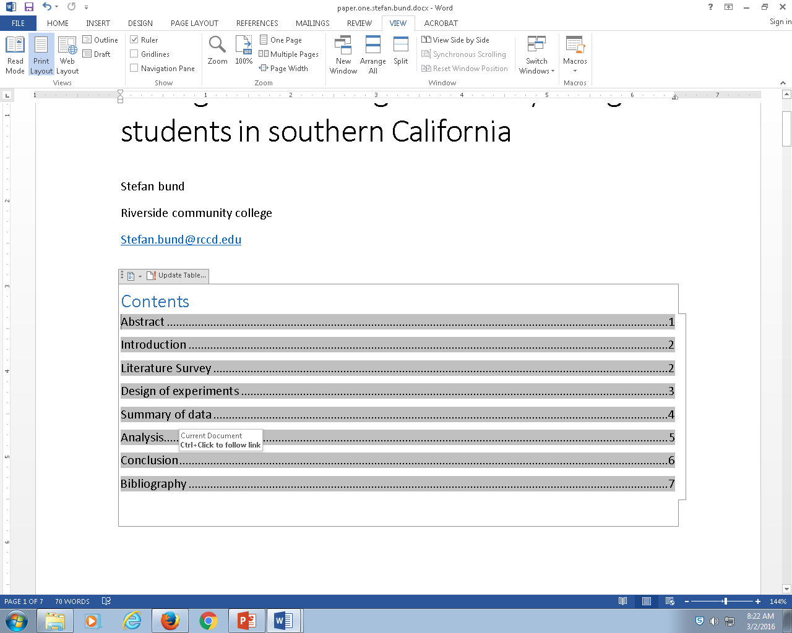
Add your literature survey to your table of contents
Do this by adding a new heading, literature survey, with style heading 1 after introduction

Slide 4
Big idea
Summarize each source with a few sentences
Add each source to your bibliography
Add your summary to your literature survey
Merge the summaries from each journal article in your summary of sources into your literature survey in your paper

Slide 5
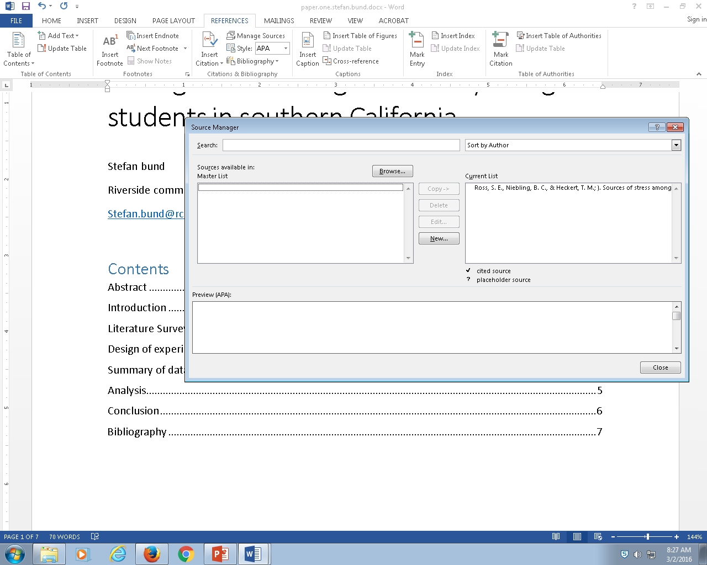
Task one
Add each source to the bibliography

Slide 6
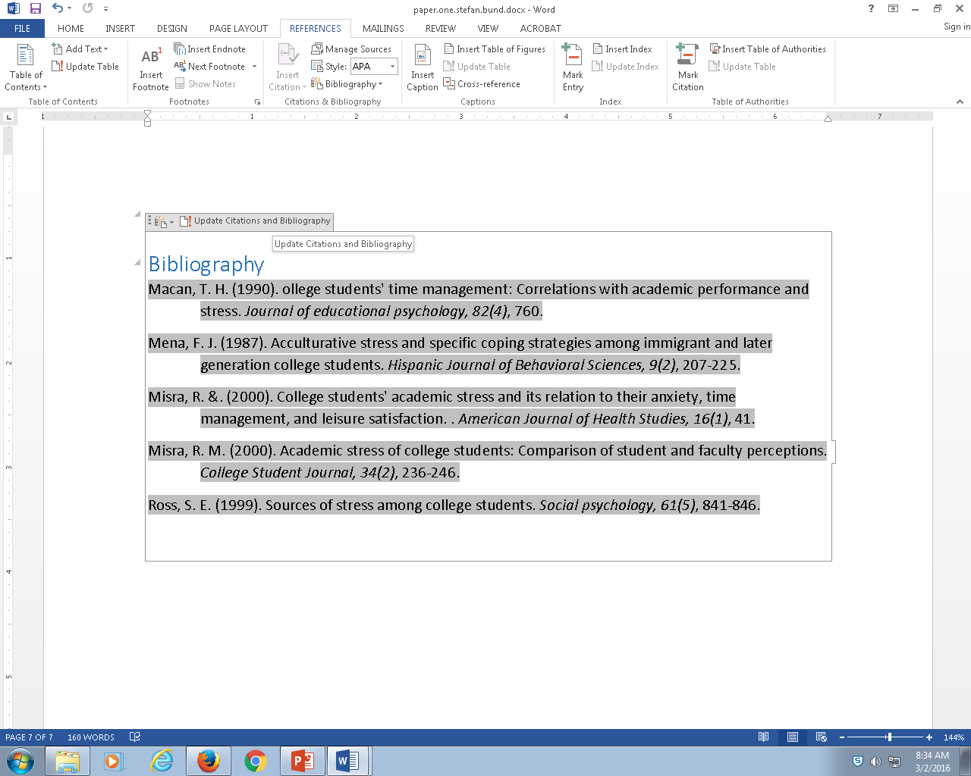

Slide 7

First, begin with a blank slate
Copy / paste your summary statements here,
Cite each statement
No copy/paste of any author’s language, just use your own language even if it isn’t perfect

Slide 8
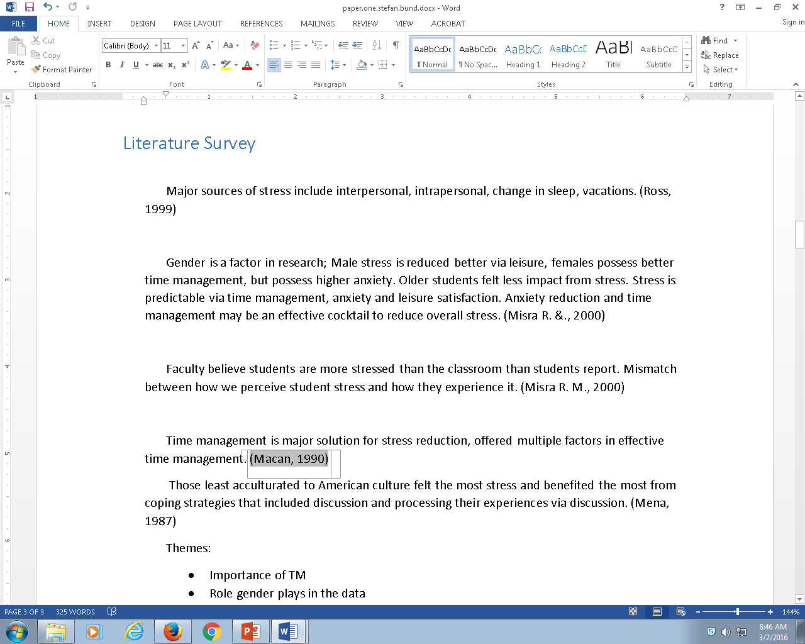

LS is initially a junkyard
Its not useful until we organize it

Slide 9
Step back, Try to organize the junkyard a bit, look for the big themes
Themes:
Importance of TM
Role gender plays in the data
Impact of behaviors which reduce stress
Impact of recovering and processing stress.

Slide 10
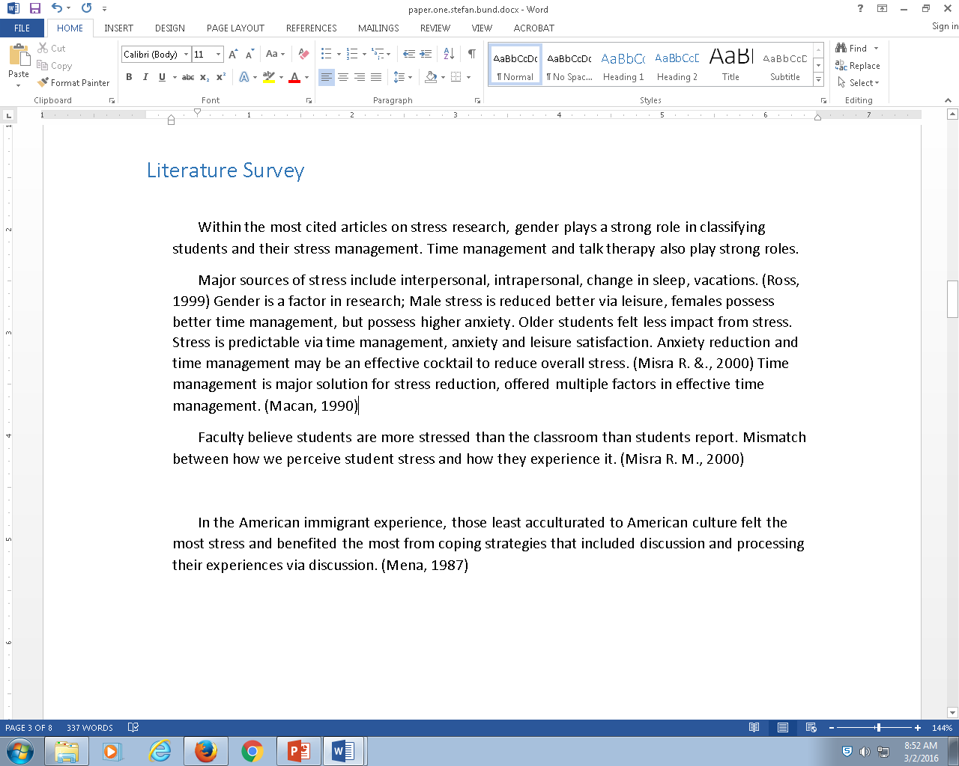
Reintegrate your analysis into your paper (junkyard)
Begin to clarify your understanding for the reader
Every time you step back and gain greater understanding of the material, you should present that to the reader

Slide 11
Research undergoes two phases
Landscape understanding: what’s come before
Learn new things
You must approach the time when you will learn new things, keep assembling sources until you identify a way to learn something new

